Slide 1
FAIR SHARE IN GLASTONBURY
October 27, 2021
Presentation for the Glastonbury Affordable Housing Steering Committee
Open Communities Alliance

Slide 2
A FAIR SHARE HOUSING MODEL FOR CONNECTICUT

Slide 3
HOUSING INEQUITY IN GLASTONBURY
 | White (non-Hispanic) | Black (non-Hispanic) | Asian (non-Hispanic) | Hispanic
Glastonbury | 80.9% | 2.1% | 8.7% | 5.8%
Hartford County | 61.1% | 12.9% | 5.3% | 18.0%
Connecticut | 66.9% | 9.9% | 4.5% | 16.1%
Source: ACS 2019

Slide 4
HOUSING INEQUITY IN GLASTONBURY
 | Percent Single Family | Percent Duplex | Percent 3 to 9 units | Percent 10 to 19 Units | Percent 20+ Units
Glastonbury | 83.33% | 2.40% | 6.10% | 1.22% | 5.96%
Hartford County | 61.26% | 7.76% | 15.81% | 4.40% | 10.19%
Connecticut | 64.31% | 8.18% | 14.08% | 3.78% | 8.84%
Source: ACS 2019

Slide 5
CT LAWS GOVERNING ZONING
Zoning Enabling Act, CGS Sec. 8-2 & Planning Mandates, CGS Sec. 8-23: These laws require that towns "encourage the development of … multifamily dwellings" to meet the regional affordable housing need and “promote housing choice and economic diversity, including housing for both low- and moderate-income households.”

Slide 6
SOLUTIONS IN OTHER STATES/PLACES
Mandatory Inclusionary Zoning – Montgomery County, Maryland
Builder’s Remedies – Connecticut and Massachusetts
Allow Duplexes, Triplexes and Quadriplexes – Minneapolis and Oregon
Regional Needs Assessment - California
Fair Share – New Jersey

Slide 7
FAIR SHARE PLANNING AND ZONING
After…
Seven years of interviews and conversations with community members, zoning board members, state officials, builders and more.
Five years of research.
Two years of deep data analysis.
We developed HB 6611, Fair Share Planning and Zoning

Slide 8
HOW MUCH AFFORDABLE HOUSING DO WE NEED?
Fair Share: STEP 1

Slide 9
BRINGING FAIR SHARE TO CT
STEP 1: Develop a Base for Housing Need
Need: Low Income and Cost Burdened Households
 | Households | Cost Burdened (paying more than than 30% of income on housing) | Severely Cost Burdened (paying more than 50% of income on housing)
Households | 1,354,715 | 474,040 | 220,695
Below 80% AMI | 570,270 | 376,850 | 208,130
Below 50% AMI | 386,670 | 293,940 | 188,010
Below 30% AMI | 214,745 | 167,495 | 135,740

Slide 10
TOWN AND REGIONAL ALLOCATIONS
Fair Share:
STEP 2

Slide 11
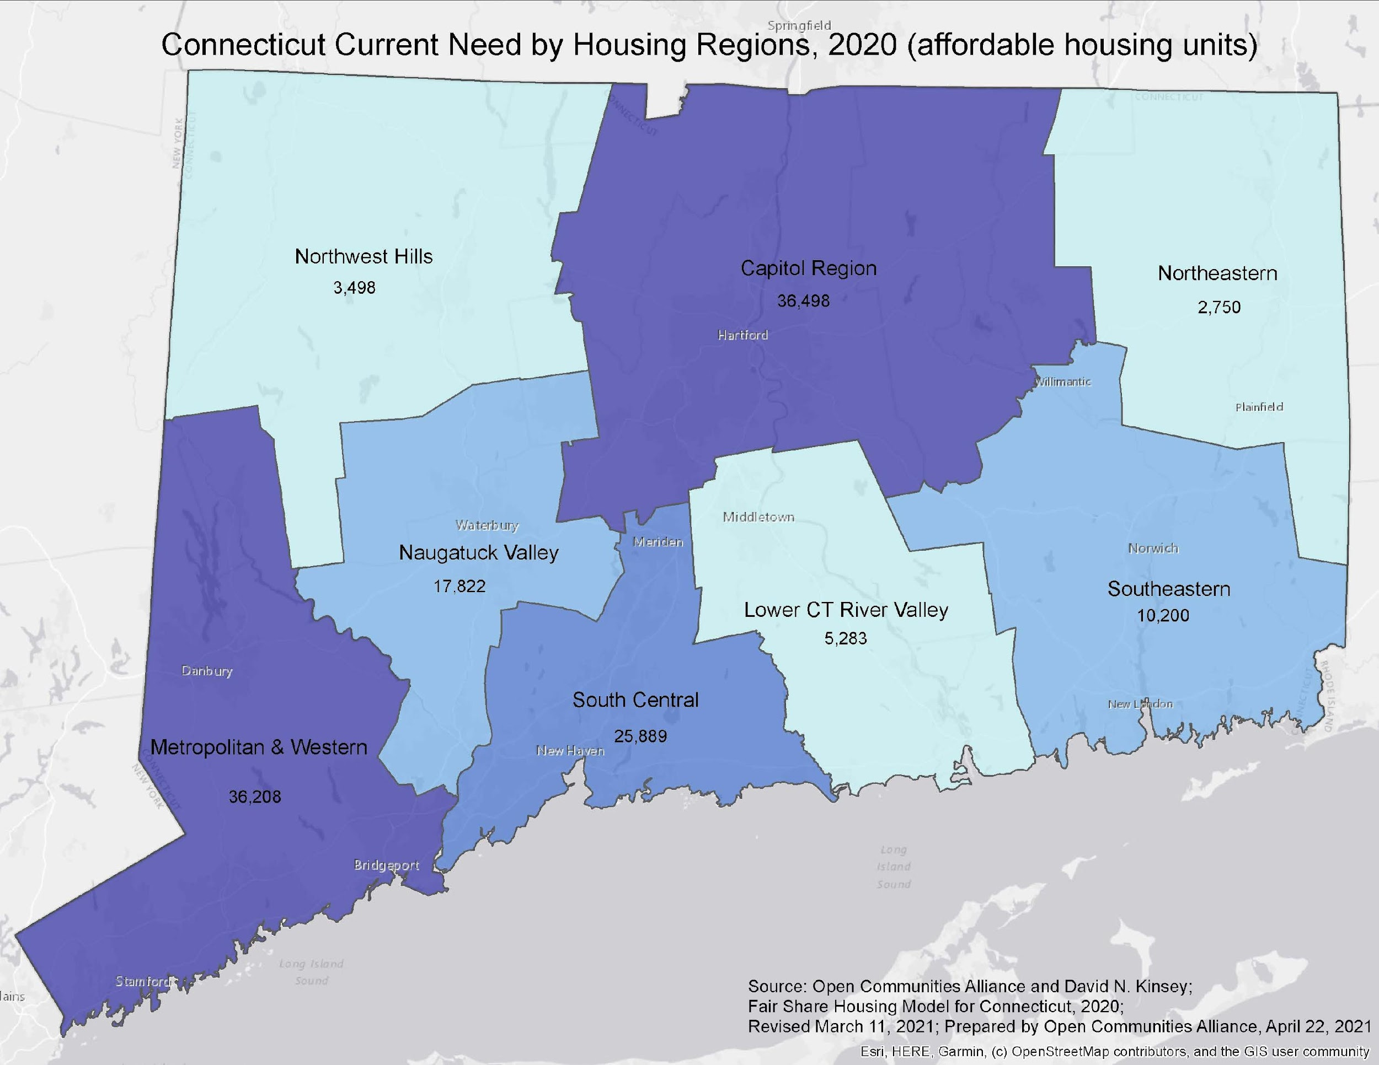
FAIR SHARE ALLOCATIONS
We consider four factors:
Income,
Wealth,
Multifamily Housing, and
Poverty
Each factor tracks back to CGS Sec. 8-2 or sound planning principles.
Towns with more than 20% poverty are not given a Fair Share Goal.
Town 10-year Fair Share Goals are capped at 20% of current housing stock. Reduces total to 120,000 units.

Slide 12
HOUSING INEQUITY IN GLASTONBURY
 | Median Income | Poverty Rate | Equalized Net Assets per Capita | Percent Multifamily | Fair Share Units (over 10 years)
Glastonbury | $120,837 | 3.6% | $178,362 | 16.77% | 1,550
Hartford County | $75,148 | 10.8% | $121,150 | 38.74%
Connecticut | $78,444 | 9.9% | $160,428 | 35.69%
Source: ACS 2019, CT Office of Policy and Management

Slide 13
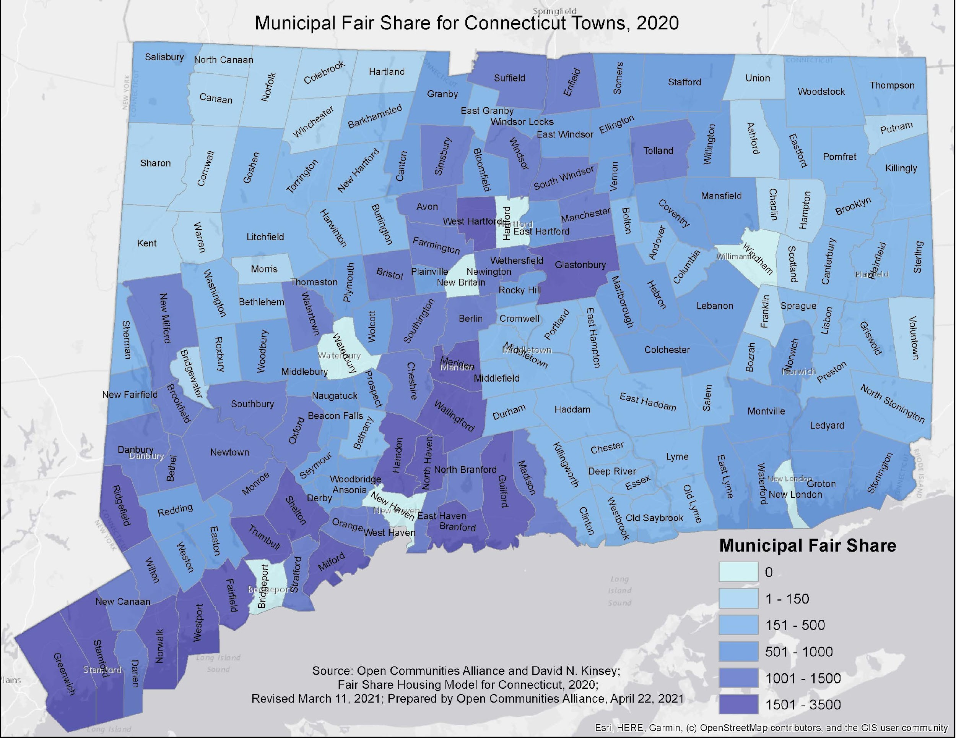
FAIR SHARE ALLOCATIONS

Slide 14
INTEGRATIVE ELEMENTS
Requirements for Housing Missing from the Market. Towns would be required to include (subject to change):
No more than 50% homeownership.
No more than 30% age restricted.
At least 10% of affordable units for 30% AMI households.
At least 50% of affordable units for 50% AMI households.
At least 30% of affordable units must be at least 2 bedrooms.
At least 20% of affordable units must be 3 bedrooms.
No more than 10% of affordable units can be studios.
All units developed must be marketed across racial lines.
Towns cannot satisfy their Fair Share obligation by planning to build only in parts of town that have higher poverty rates.

Slide 15
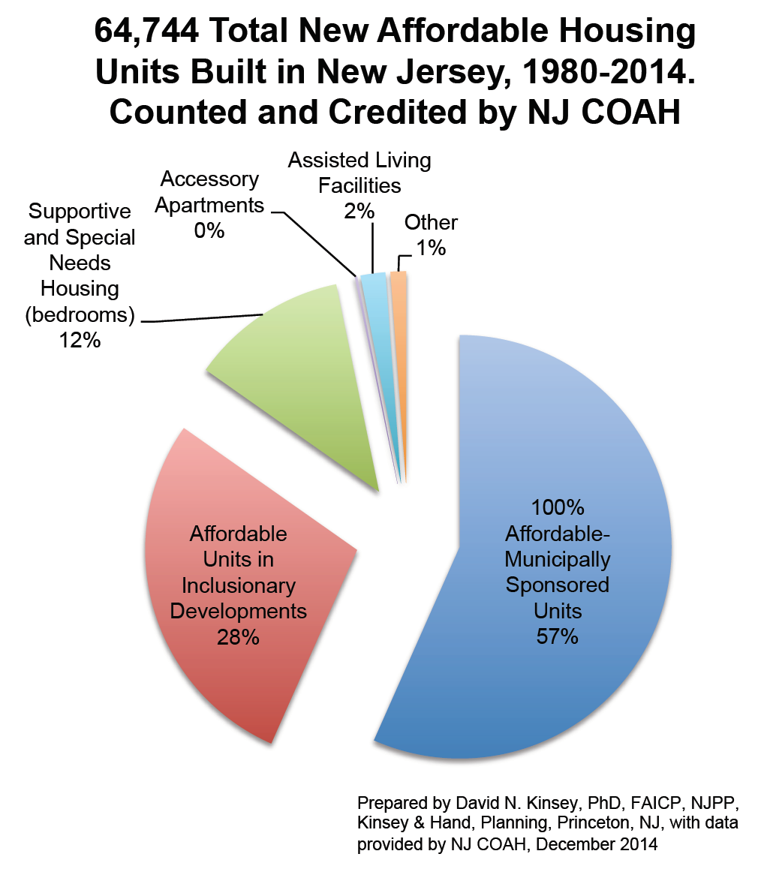
FAIR SHARE: NEW JERSEY SUCCESS
Potential Economic Impacts (NAHB, 2019)
Income for CT Residents | $ 59.1 Billion
State and Local Tax Revenue | $ 12.2 Billion
Jobs (FTEs sustained for 10 years) | 79,299

Slide 16
HOW WILL LOW-INCOME CHILDREN BENEFIT FROM FAIR SHARE?
Improved Health Outcomes
E.g. The September 2021 edition of Housing Policy Debate reports that researchers from Johns Hopkins found an over 30% decrease in asthma and mental health hospital admissions for children whose families use a voucher to move out of high poverty areas. Fewer cases of asthma and mental health challenges among low-income children translates into genuine opportunities to break the cycle of poverty, decreasing the workload for all legal services providers.
Access to Higher Performing Schools
Fair Share would produce at least 40,000 2- and 3-bedroom units in some of the highest performing school districts in the state.
Greater support for poverty-alleviating measures at the Legislature.
Increased cross-racial/ethnicity relationships
= Decreased racism
= Increased tolerance/acceptance of differences

Slide 17
Lessons from Zoning for Equity

Slide 18
Prioritize Affordable Rental Housing Accessible to Lower Income Families
“Possible Housing Strategies” (PHS) emphasizes that “Glastonbury wants to be more inclusive as a community.”
Per 2019 § 8-30g list (only 2 unit difference from 2020):
477 of 781 (or 60%) § 8-30g units either:
Age-restricted government-assisted (346); or
Subsidized mortgages (131).
Welles Village: 199 of other 304 units (dates back to World War II).
Clear unmet need for affordable, non-age restricted, rental units.
Plan should focus on need for non-senior housing.
Do not place high priority on CHFA / USDA mortgages (PHS 4.7) or deed restriction for homeownership (PHS 2.3(2)(b) through 2.3(d)).

Slide 19
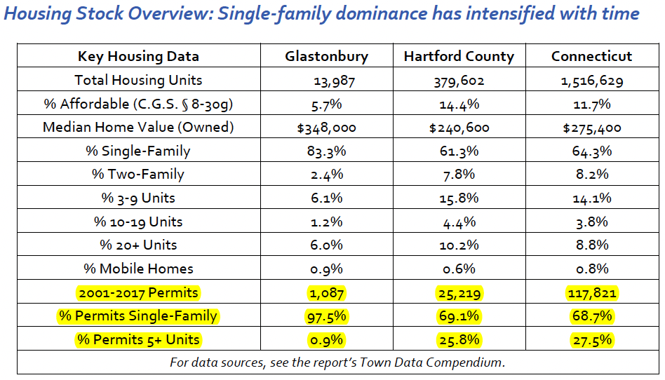
Existing Multifamily Provisions Fall Short

Slide 20
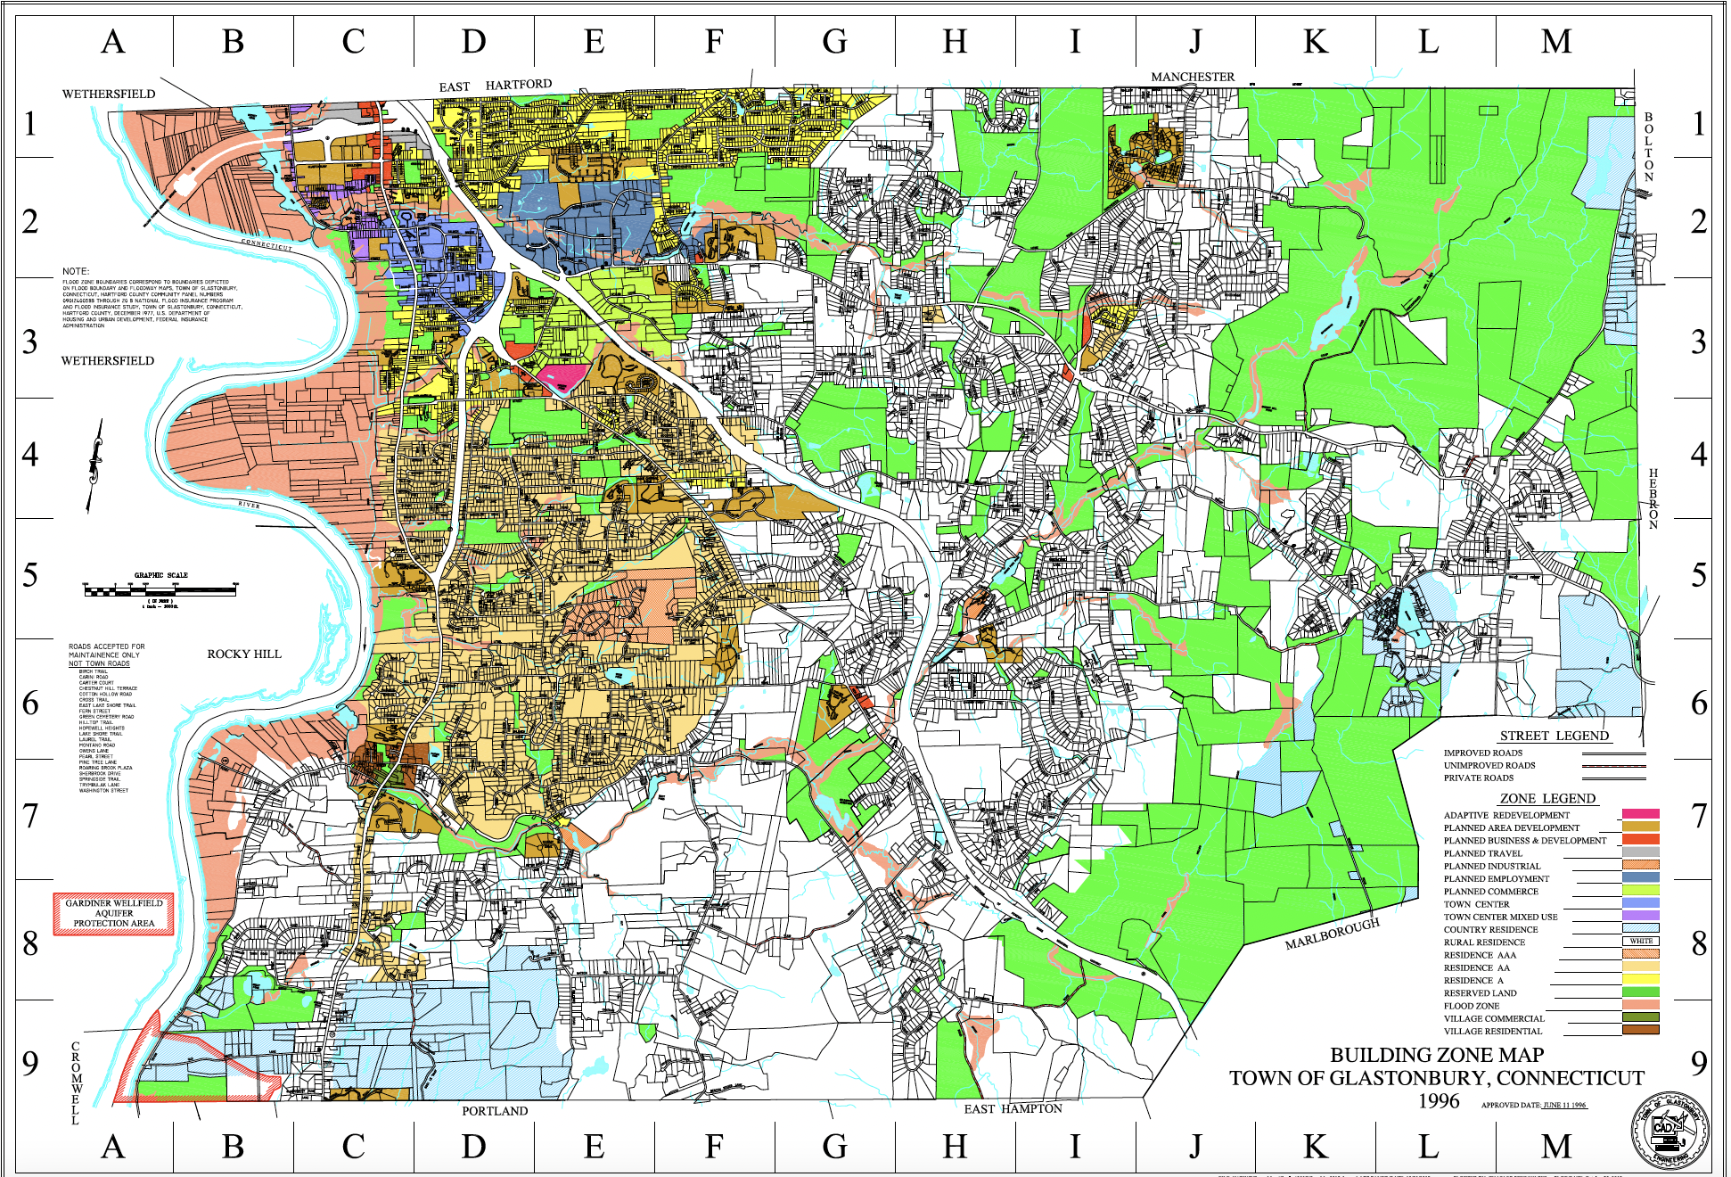
Need More (and Less Onerous) “Tools”
for Multifamily throughout Glastonbury

Slide 21
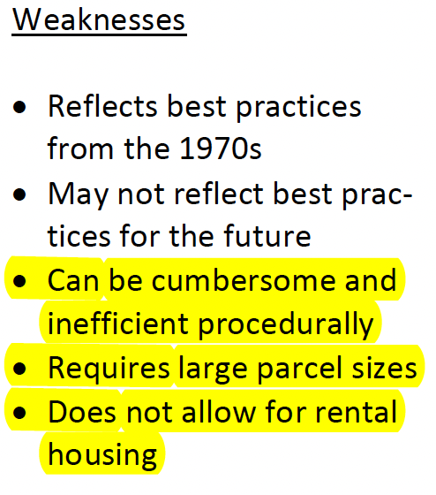
“Possible Housing Strategies” Echoes Concerns Raised in Zoning for Equity

Slide 22
Exceedingly Low Density Another Issue for
PAD / Other Multifamily Provisions
This is a planning problem . . .
2018 POCD defines “medium density” areas as “primarily composed of single-family homes on a minimum of one acre.”
Nat’l Assoc. of Homebuilders: median single-family net-residential density 3.2 units per acre.
. . . And a zoning problem.
PAD: 0.5 to 3 units/acre generally; “affordable dwelling units” (only AA & A), up to 6 units/acre.
Similarly, Town Center Mixed Use (TCMU) Zone: 6 units/acre.
Compare PAD when “elderly or elderly congregate housing”: 11 units/acre.

Slide 23
Zoning for Equity Introduction /
Other Sections Offer Valuable Guidance
Lesson 1: Addressing planning, not just zoning, is critical.
Good: PHS 4.5(1)(a) “Consider elevating housing and housing options / choices to a major focus of POCD.”
Concern: PHS 4.5(3) re: Concentrating any future growth to limited areas (e.g., around “community nodes,” on major roads, on water/sewer, etc.).
Lessons 3 and 6: Do not unduly limit multifamily areas (i.e., with infrastructure).
Modern septic / well technology enables multifamily off water/sewer
Consider how to “Expand Housing Options / Choices” throughout town, not just in certain locations/areas (relevant to PHS 3.3(2) and (3)).
Lesson 8: Do not over rely on accessory dwelling units (ADUs).
Unlikely large number of homeowners will build ADUs.
More likely to house family members than to rent.
Cannot guarantee affordability (Public Act 21-29 prohibits affordability mandates for ADUs).
Not conducive to addressing needs of low-income families.
All relevant to PHS 3.2(1)(a).
Encourage Committee to refer to intro, conclusion, and other town analyses.
Towns selected were illustrative; could not address every issue in every town.
Important to avoid concerns raised in other chapters when crafting recommendations.

Slide 24
Sam Giffin, M.C.P.
Policy and Data Analyst
sgiffin@ctoca.org
Roger Maldonado, Esq.
Staff Attorney
rmaldonado@ctoca.org
Open Communities Alliance
75 Charter Oak Avenue
Suite 1-200
Hartford, CT 06106
Tel. 860.610-6040
Check us out and join the coalition at: http://www.ctoca.org.

